Slide 1

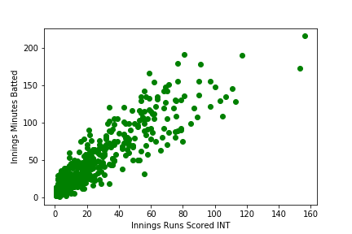
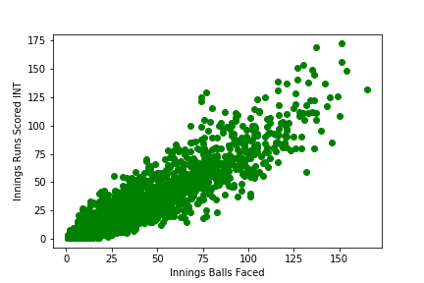

CRICKET PREDICTIONS
Sai Prakash Reddy Mamidi
School of Computer Science and Information Systems, Northwest Missouri State University
Introduction
Results
Conclusions
Cricket is one of the most popular game worldwide. And cricket is most played and viewed game in India. I’m going to predict who is going to score more runs in a game.
Based on the scatter plot on the left we can say that most of the players will score high if they get to play longer duration
Based on the scatter plot on the right we can say that the most of the players will score high if they play more number of balls
Predicting the most number of runs scored by a batsmen in a game
Provides a graphical representation of number of runs scored by a batsman depending on how much time he bats.
I have performed clustering to determine how much a batsman will score depending on his previous scores.
Materials/Methods
Features:
Innings Runs Scored Num
Innings Minutes Batted
Innings Runs Scored Num
Performed Linear Regression
Used Decision Tree Classifier to implicitly perform feature selection
Additional Resources
Acknowledgements
Poster Repository
https://scikit-learn.org/stable/modules/generated/sklearn.tree.DecisionTreeClassifier.html
https://www.kaggle.com/cclayford/cricinfo-statsguru-data
Mentor: Dr. Charles Hoot
https://github.com/prakashreddy-97/ML_Poster.git

